Slide 1
Web Application Penetration Testing
Project 57: develop tool to detect open directories and security misconfigurations
K BALA THRIPURA VENKATA SRIVALLI AP22110011471 CSE-Y

Slide 2
Problem Statement:
Modern web applications often suffer from improperly configured servers, frameworks, and environments. These misconfigurations may lead to serious security vulnerabilities like unauthorized access, data leaks, or even full system compromise. The project aims to create an automated tool that scans web applications for open/exposed directories and common security header misconfigurations.

Slide 3
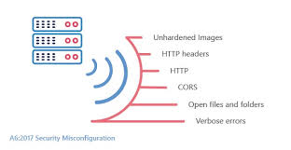
Security Misconfigurations: the improper or inadequate configuration of security settings within software, hardware, applications, or networks, leading to vulnerabilities that can be exploited by attackers Types:
Open directories
HTTP headers
CORS
Leaked Server Info
Insecure Cookies

Slide 4
Misconfiguration Type | Description
Missing X-Frame-Options | Allows clickjacking by letting the site be embedded in iframes.
Missing X-Content-Type-Options | Browser may interpret files as a different MIME type, leading to XSS attacks.
Missing Content-Security-Policy | Increases risk of XSS or code injection by allowing unsafe scripts to run.
Missing Strict-Transport-Security | Allows downgrade and man-in-the-middle attacks by not enforcing HTTPS.
Exposed Open Directories | Public folders like /admin/, /uploads/, .git/, etc., may expose sensitive files.
Overly Permissive CORS Policy | Access-Control-Allow-Origin: * lets any domain access resources, risking data theft.
Insecure Cookies (No HttpOnly, Secure, SameSite) | Cookies may be stolen via XSS or exposed over insecure channels.
Leaky Server Details in Headers | Headers like Server or X-Powered-By reveal tech stack info useful to attackers.

Slide 5
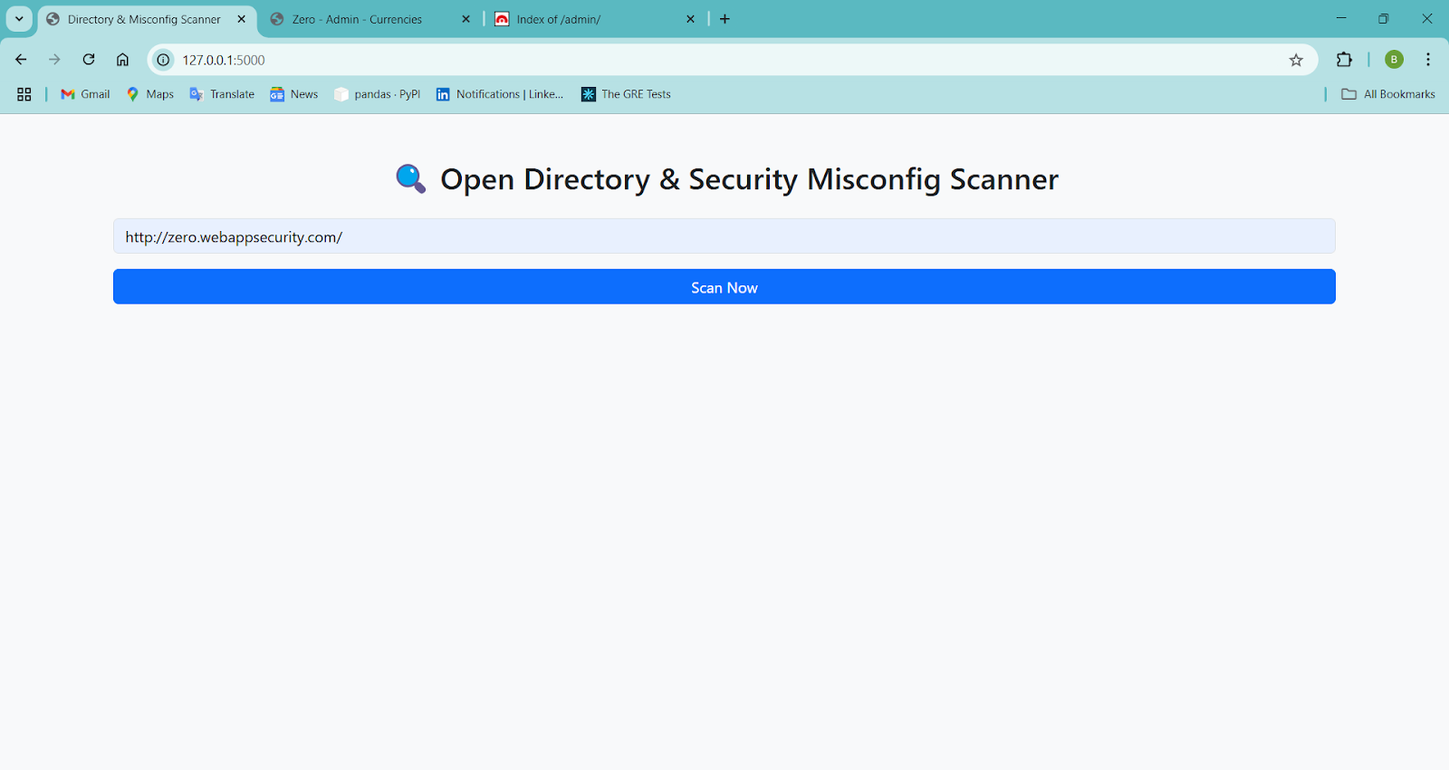
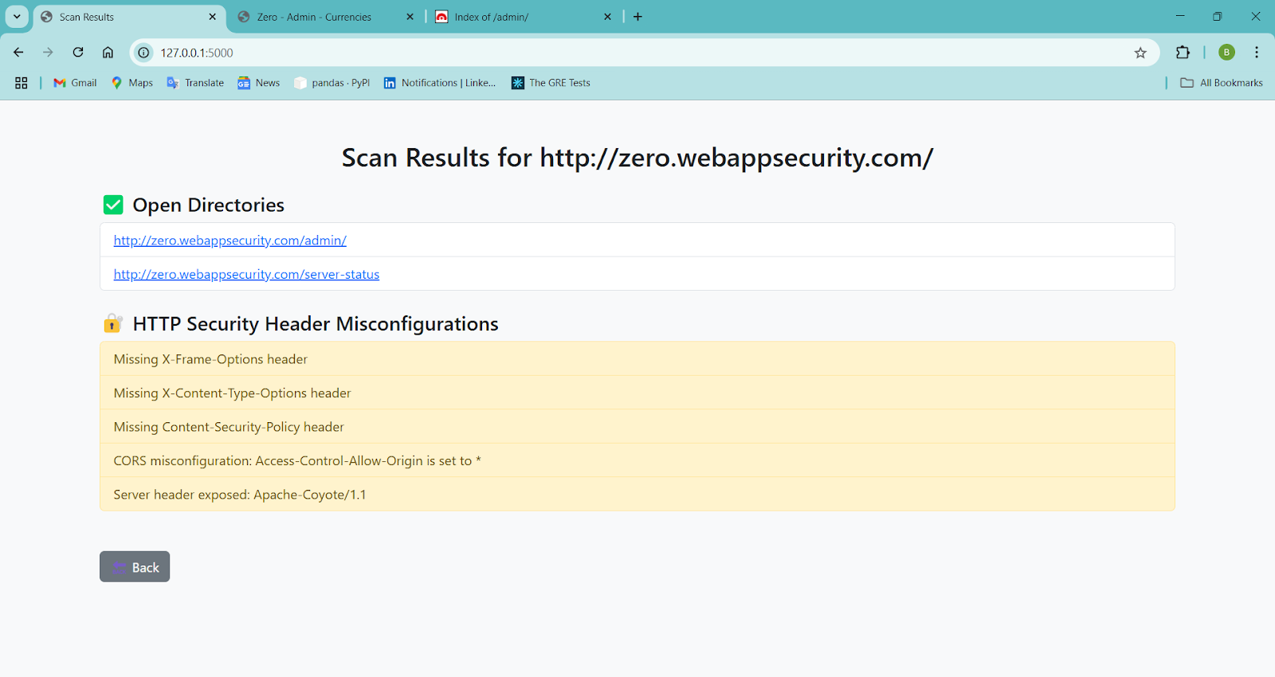
Solution I came up with:
Developed a web page using flask , in which by giving url of the required site the tool detects the misconfigurations and open directories. Github repo: https://github.com/kbtvs/WAPT

Slide 6
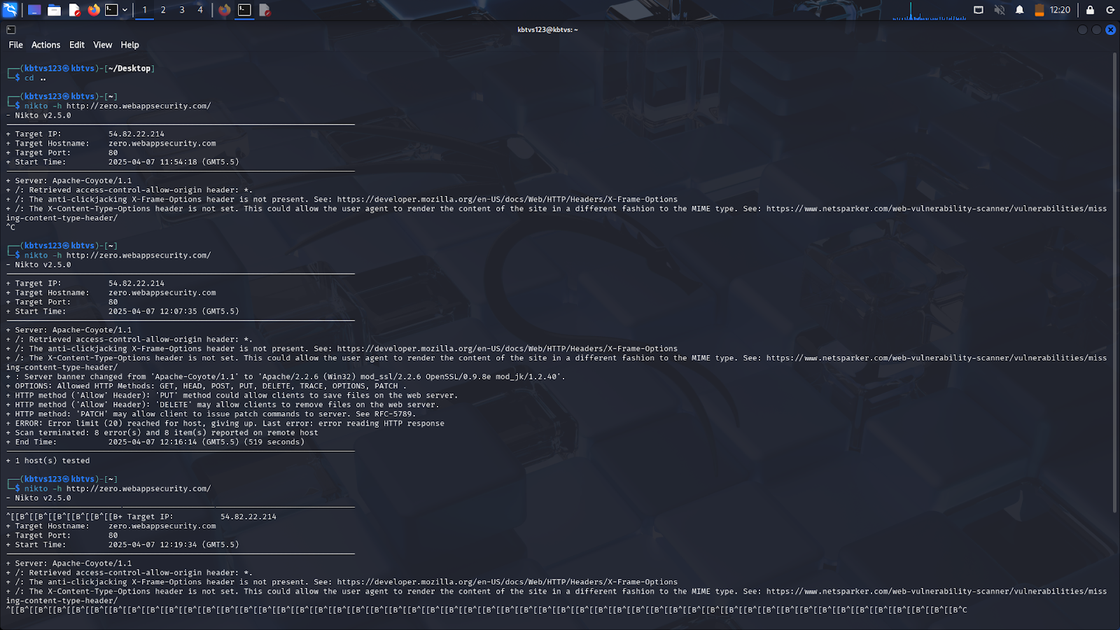
Scanned the web url using kali linux tool nikto command: nikto –h <url> eg: nikto –h http://zero.webappsecurity.com/
Nikto: Nikto is a free, open-source, command-line web server vulnerability scanner that checks for dangerous files, outdated server software, and other security issues.

Slide 7

Impact of these misconfiguration
Clickjacking
Session Hijacking
Server Code Leakage
Cross Site Scripting
Reconnaissance Exposure

